Slide 1

Guidelines for Coursework:
ENGP001 English Communication Skills
L4 SE/CS
2023 SEP INTAKE
WEIGHTAGE - 50% MODULE GRADE

Slide 2
Group Assignment (Teams of 4-6 members)
Task:
  Pick a person/role model of your choice (living or deceased) and create a presentation revolving around the chosen person's life - their backgrounds, challenges they faced, what is most inspiring about them, etc.
  You can use slides or any other form of graphics/media as you deem appropriate.
  Max. length of the presentation = 7 mins
  Use Harvard Referencing Style and create a Bibliography (list of sources you referred to) at the end of your presentation.
  The last slide of the presentation should clearly indicate student IDs, names, and roles played.
Topics/techniques you should showcase: research, critical reading, presentation skills, grammatical concepts covered in the module, and creativity.
You will be marked on your content clarity and structure, language proficiency, presentation delivery techniques, engagement and confidence, use of visual aids, time management, contribution and dress code (professional attire).
Your team allocation can be found on this sheet.
  The batch rep should update IIT email addresses, team names and team leader details (columns D, F and G on the team allocation sheet)

Slide 3
How to submit your work?
Upload your finalized slides on LMS through the Submission link relevant to your group, latest by Friday, 17th November 2023.
The submission link will be made available in due time.
No changes will be allowed after you submit the presentation through the link.
Note: Only the Team Leader should submit the file.
The presentation should be named as follows:
<Tutorial Group (eg: G1)>_<Team Name>_<Name of Team Leader>_<IIT Student ID of Team Leader>
The maximum document size allowed on LMS is 50MB. If you plan on using videos, you may insert links to your presentation.
On the last slide, include the Names, Student IDs and the contribution of each team member.
You will deliver your presentation in-person during the week starting 20th November 2023. The schedule is given in the next slide.
You are required to wear a name tag when presenting.
All members of the group are required to present.

Slide 4
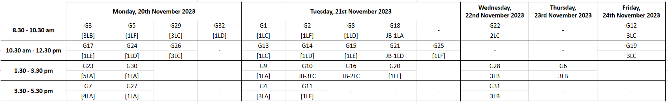
You will deliver your presentation in-person during the week starting 20th November 2023, as per the following schedule.
All students of the relevant tutorial group are required to
stay in class throughout the 2-hour session
be punctual and be present at the assigned classroom at the start of the session
be silent while others are presenting.

Slide 5
Think fresh and out-of-the-box!
If you have any questions, contact your tutorial lecturer directly.
Submission Date for Slides: 17th November, 2023
In-person Presentations: Week commencing 20th November 2023 (Schedule shared)

